Slide 1
TACHYON SYSTEMS FRONT-END DEVELOPER
- MAHESHWARI R
JEPPIAAR ENGINEERING COLLEGE

Slide 2
PRIMARY TOPICS
Web Fundamentals → HTML5, CSS3 (Flexbox/Grid), JavaScript ES6+
React → Components, Hooks, Routing, State Management
Web Components → Shadow DOM, reusable components
Testing → Jest, React Testing Library, Cypress/Playwright

Slide 3
WEB FUNDAMENTALS
HTML5:
HTML5 is the latest version of HyperText Markup Language used to structure web pages. It introduced semantic elements, new form controls, multimedia support (audio/video), graphics and offline storage, making websites more powerful, accessible, and user-friendly.
TAGS:
Semantic Elements → <header>, <footer>, <section>, <article>
Forms → <input type="email">, <input type="date">
Media Support → <audio>, <video>

Slide 4
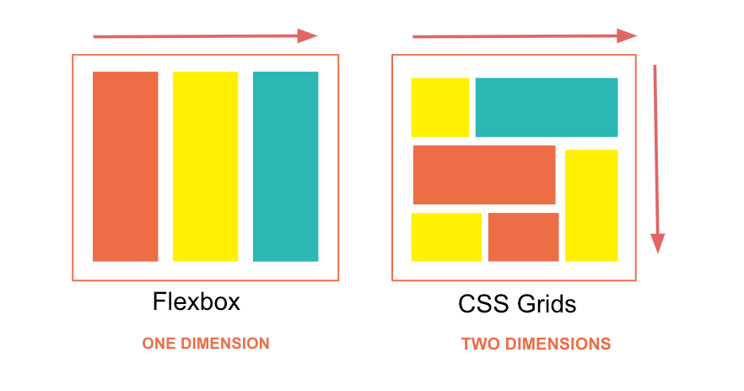
WEB FUNDAMENTALS
CSS3:
CSS3 is the latest version of Cascading Style Sheets used to style and design web pages. It introduced modern layout models like Flexbox and Grid, media queries for responsiveness, advanced animations, transitions, and enhanced visual effects to create interactive, mobile-friendly websites.
LAYOUTS:
Flexbox → 1D Layout (row or column)
Grid → 2D Layout (rows & columns)
Media Queries for responsiveness
Animations & Transitions

Slide 5
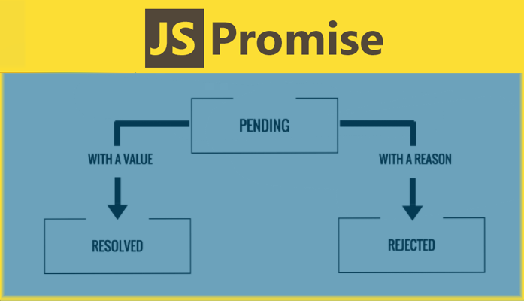
WEB FUNDAMENTALS
JavaScript ES6+:
JavaScript ES6+ is the modern version of JavaScript that powers interactivity in web pages. It introduced features making code more readable, efficient, and suitable for building modern frameworks like React.
FEATURES:
let & const → Block-scoped variables
Arrow Functions → Shorter function syntax
Modules (import/export) → Code organization
Promises & Async/Await → Handle API calls

Slide 6
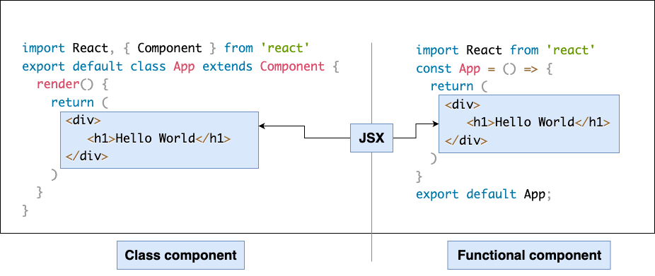
REACT
REACT:
React is a popular JavaScript library for building fast, reusable, and interactive user interfaces. It uses a component-based architecture, virtual DOM for performance, and supports efficient state management.
COMPONENTS:
Building blocks of React UI
Functional Components (modern standard)
Class Components (older, less used now)
Reusability (Navbar, Button)

Slide 7
HOOKS
Hooks are special functions in React that let functional components manage state and lifecycle features. They make React code simpler and more reusable without using class components.
Common HOOKS:
useState → manage data
useEffect → side effects (API calls, timers)
useContext → global state sharing

Slide 8
ROUTING & STATE MANAGEMENT
ROUTING:
Routing in React is handled by React Router, enabling navigation between different views without reloading the page.
Managed by React Router.
Enables multiple pages in a single-page app.
STATE MANAGEMENT:
State management ensures consistent data across components.
Small apps → Context API.
Large apps → Redux.

Slide 9
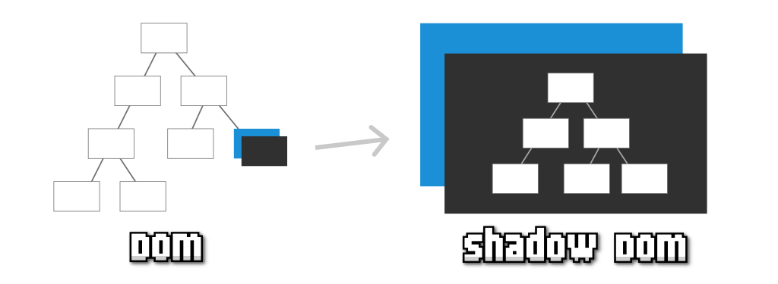
WEB COMPONENTS
Web Components are reusable custom elements built using standard web APIs. They provide encapsulation with Shadow DOM and allow creating consistent UI across applications.
SHADOW DOM:
Shadow DOM provides encapsulation, isolating a component’s structure and styles from the rest of the page.
Avoids CSS conflicts with global styles.
Each component has its own DOM tree.
Example: A <datepicker> component with internal styling.

Slide 10
WEB COMPONENTS
REUSABLE COMPONENTS:
Reusable components are custom elements that can be used across different projects for consistency.
Encapsulated HTML, CSS, and JS.
Framework-agnostic (works in plain JS, React, Angular).
Helps in building design systems

Slide 11
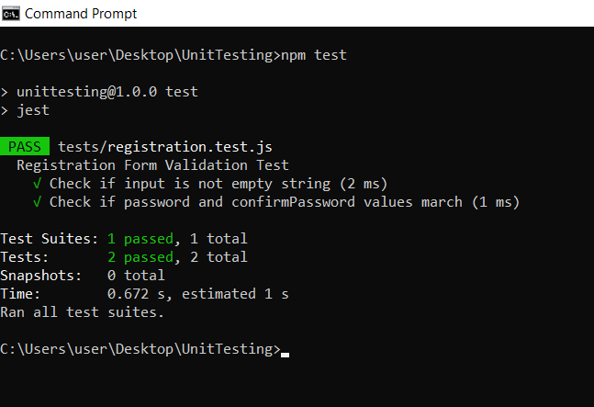
TESTING
Testing ensures that applications work as expected, are reliable, and free from bugs. Different tools are used for unit, component, and end-to-end testing.
JEST:
Jest is a JavaScript testing framework mainly used for unit tests.
Fast and easy to set up.
Tests individual functions or logic.
Example: checking if 2+2 = 4.

Slide 12
TESTING
REACT TESTING LIBRARY (RTL):
React Testing Library tests React components by simulating real user interactions.
Focuses on behavior, not implementation.
Tests clicks, form inputs, rendering.
Example: button click updates counter.
CYPRESS/PLAYWRIGHT:
Cypress and Playwright are End-to-End (E2E) testing tools that test the entire app flow in the browser.
Simulate real user journeys.
Test login, navigation, and form submission.
Catch integration issues before release.

Slide 13
SECONDARY TOPICS
RESTful APIs → Integrating frontend with backend
Authentication & Authorization → JWT, OAuth2
Performance Optimization → Lazy loading, memorization
UML Diagrams → Component hierarchy diagrams
System Design Basics → Client-server architecture

Slide 14
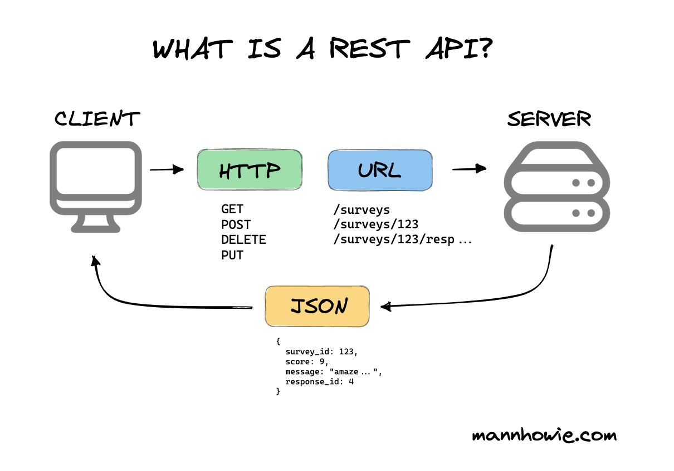
RESTFUL API’s
RESTful APIs allow the frontend to communicate with the backend using standard HTTP methods.
Uses GET, POST, PUT, DELETE for CRUD operations.
Data often exchanged in JSON format.
Example: React app fetching user details from backend.

Slide 15
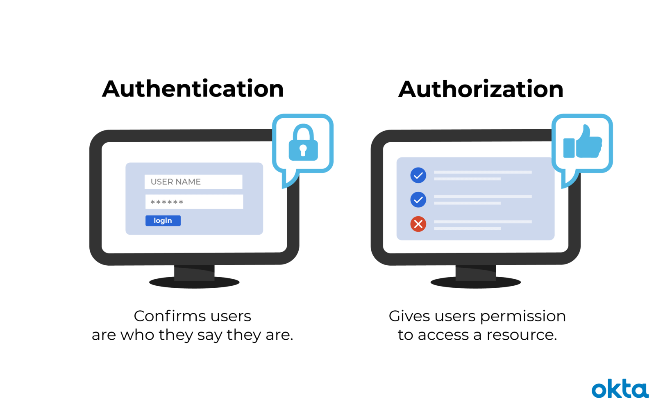
AUTHENTICATION & AUTHORIZATION
Authentication verifies identity, while Authorization defines access levels after login.
JWT (JSON Web Token): Token stored in browser for secure API calls.
OAuth2: Login via providers like Google, GitHub.
Ensures data privacy and role-based access.

Slide 16
PERFORMANCE OPTIMIZATION
Optimization techniques improve app speed, responsiveness, and user experience.
Lazy Loading: Load components/images only when needed.
Memoization: Avoid unnecessary recalculations (useMemo, useCallback).
React.memo: Prevents re-renders when props don’t change.

Slide 17
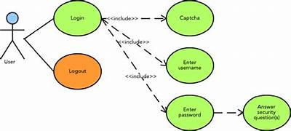
UML DIAGRAMS
UML diagrams visually represent component hierarchy and system workflows.
Helps visualize components, workflows, and relationships.
Common diagrams: Use Case, Activity, Sequence, Class, Component.
Used by developers, analysts, and testers for communication
Example in frontend: Component hierarchy diagram (App → Header → Navbar → Footer).

Slide 18
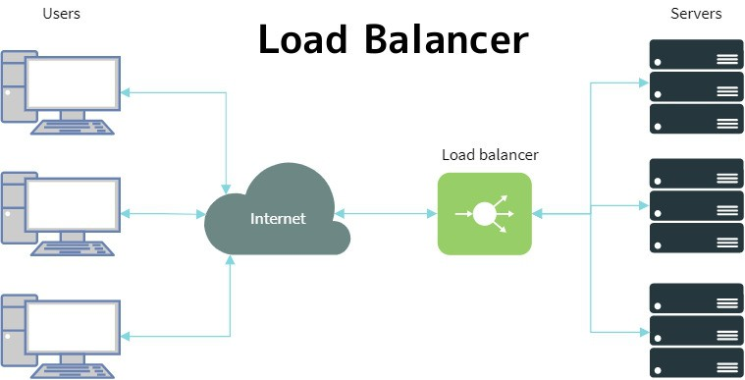
SYSTEM DESIGN BASICS
System design defines how client, server, and database interact to build scalable applications.
Client-server architecture → Browser ↔ Server ↔ Database.
Caching → Store frequently accessed data (e.g., Redis) for faster performance.
Load Balancing → Distributes user requests across multiple servers.

Slide 19
THANK YOU

